Slide 1



Enhancing and Validating Forms
Mark J. Buckler
OCPJP,CIWJS

Slide 2

Credits
Some of the contents of this slide presentation have been referenced and reproduced from the textbook for this course, JavaScript (Sixth Edition) , Sasha Vodnik and Don Gosseling, ©2015, 2011, Cengage Learning, All Rights Reserved. ISBN 978-1-305-07844-4.

Slide 3
LEARNING OBJECTIVES
Enhance form usability with JavaScript
Customize browser-based HTML validation
Implement custom validation to check for errors and display error messages

Slide 4
Using JavaScript with Forms
Validation
Checking that form information provided by users conforms to data rules
Provided in a format that the site’s back-end programming can work with
form object
Represents a form in an HTML document
Used to access form and its data

Slide 5
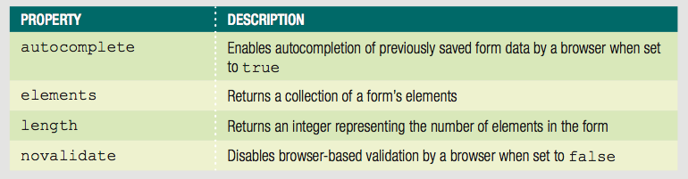

Using JavaScript with Forms
Properties of form Objects
Event of form Objects

Slide 6
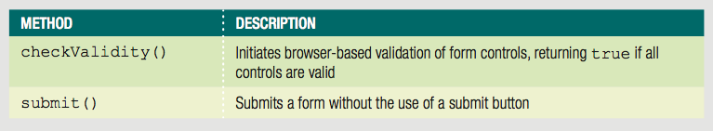
Using JavaScript with Forms
Methods of form Objects

Slide 7
Working with Input Fields
Common Elements for Collecting form Data
input
select
option
textarea
button

Slide 8
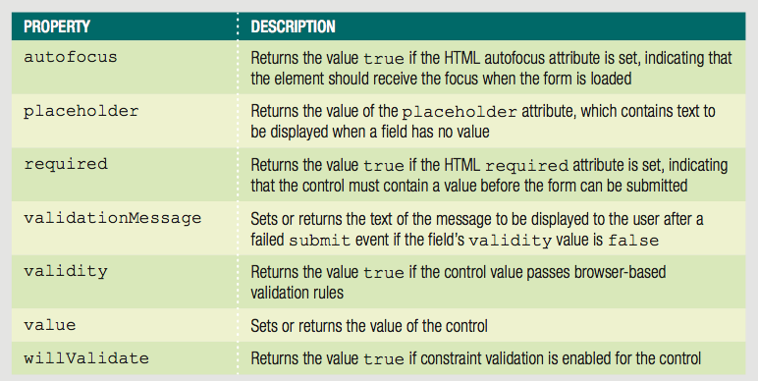
Working with Input Fields
Properties of Elements Within Forms

Slide 9
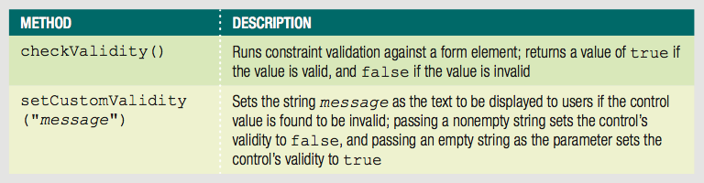
Working with Input Fields
Methods of Elements Within Forms

Slide 10
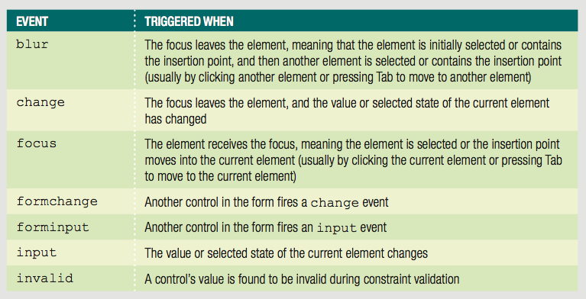
Working with Input Fields
Events of Elements Within Forms

Slide 11
Working with Input Fields
Referencing Forms and Form Elements
Can use getElementsByTagName() method: getElementsByTagName("form")[0]
document object includes a forms[] array
Contains all forms on a web page
form object has an elements[] array
Contains objects representing each control in a form
Reference form index number in the forms[] array
Followed by the appropriate element index number from the elements[] array

Slide 12
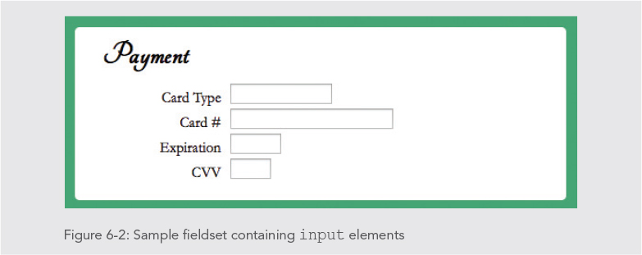
Working with Input Fields
Programming Exercise 01_06_01 – Step 1
Exercise Setup

Slide 13
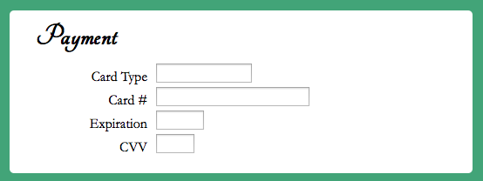
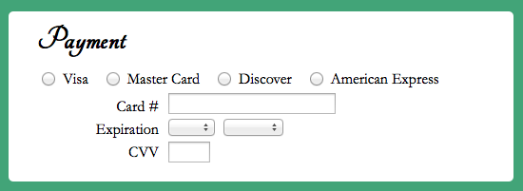
Form Usability and Accuracy
Design to Collect More Accurate Content
Before validation can reduce amount of validation necessary
Replace input boxes with other field types that present more control

Slide 14
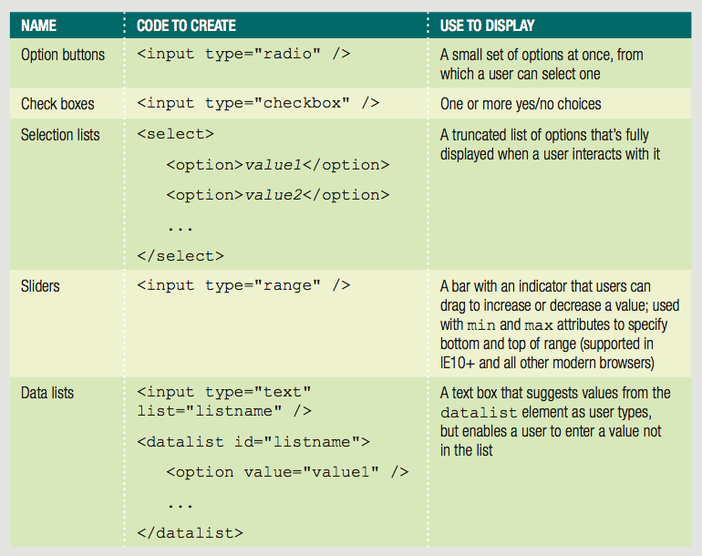
Form Usability and Accuracy
Design to Collect More Accurate Content

Slide 15
Form Usability and Accuracy
Program to Collect More Accurate Content
Assistive functions
Reduce likelihood of user errors
Prevent users from entering erroneous data
Removing default values from selection lists
Can set default value for selection list in HTML to one of the options
JavaScript can set selectedIndex property to -1
Corresponds to no selection
Forces deliberate user choice, reducing errors

Slide 16
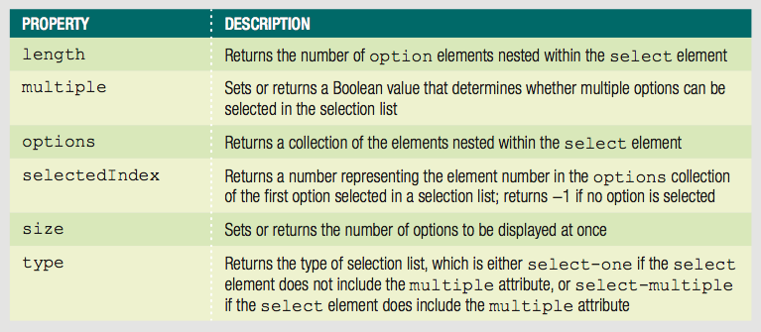
Form Usability and Accuracy
Program to Collect More Accurate Content
select Element Useful Properties

Slide 17
Form Usability and Accuracy
Programming Exercise 01_06_01 – Step 2
Program to Collect More Accurate Content

Slide 18
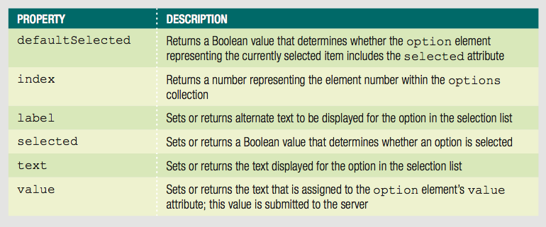
Form Usability and Accuracy
Dynamically Updating Selection List Values
Can add or remove option elements from a select element using node methods we learned
Can also use properties to get or modify the options

Slide 19
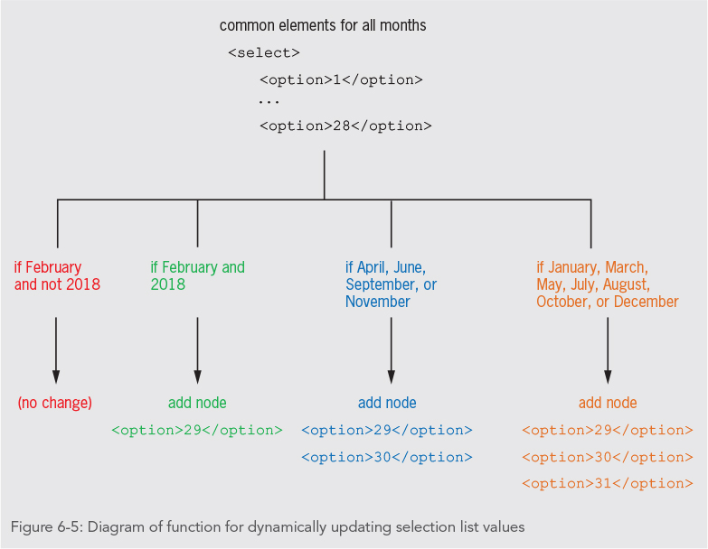
Form Usability and Accuracy
Dynamically Updating Selection List Values

Slide 20
Form Usability and Accuracy
Programming Exercise 01_06_01 – Step 3
Dynamically Updating Selection List Values

Slide 21
Form Usability and Accuracy
Automatically Updating an Associated Field Based on a User Entry
Multiple elements may be associated
Example: check box to indicate textarea entry
Can automatically change value of one field in response to change in other field

Slide 22
Form Usability and Accuracy
Programming Exercise 01_06_01 – Step 4
Automatically Updating an Associated Field Based on a User Entry

Slide 23
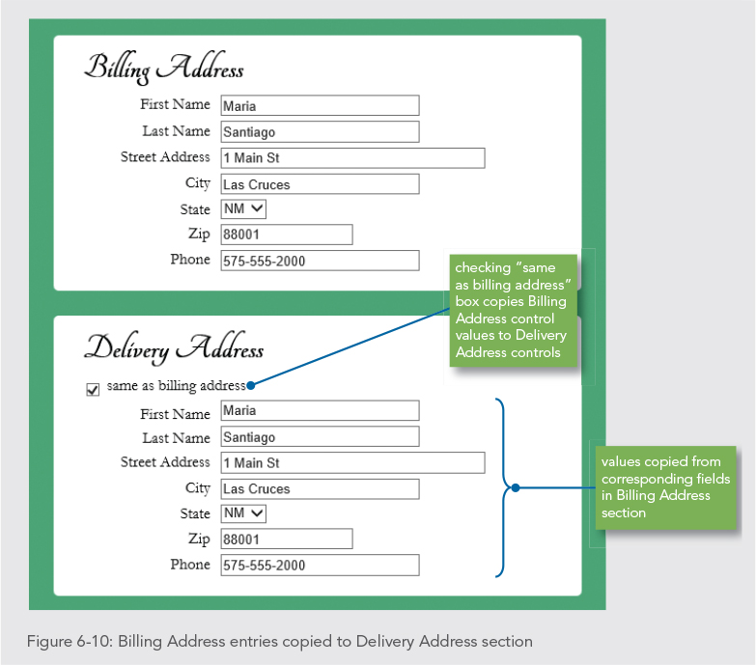
Form Usability and Accuracy
Transferring Duplicate Field Values
Can copy data from one field to another based on user indicating they should have the same value
Example: Shipping Address and Billing Address

Slide 24
Form Usability and Accuracy
Programming Exercise 01_06_01 – Step 5
Transferring Duplicate Field Values

Slide 25
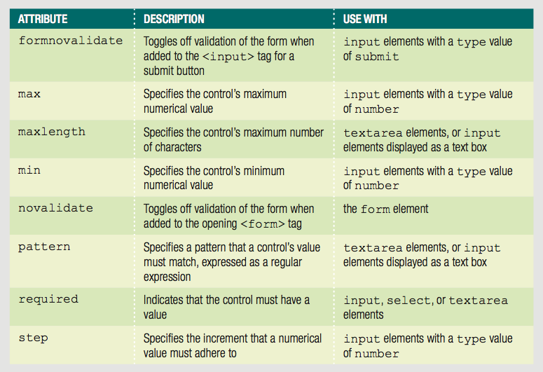
Browser-Based Validation
Browsers can Perform some HTML5 Validation
Specifying browser-based validation parameters

Slide 26
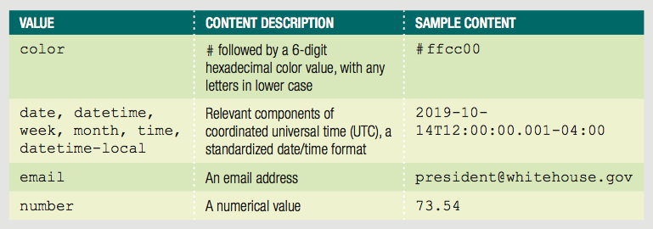
Browser-Based Validation
Browsers can Perform some HTML5 Validation
Additional validation linked to <input> type

Slide 27
Browser-Based Validation
Customizing Browser-Based Validation Feedback
Modern browsers display feedback in similar ways, with small variation
Displayed after submit event triggered
Invalid controls highlighted
Bubble displayed next to a control
Customizable through constraint validation API
validity object is part of the API, has properties
All properties of validity object must have value of false for an element to be valid

Slide 28
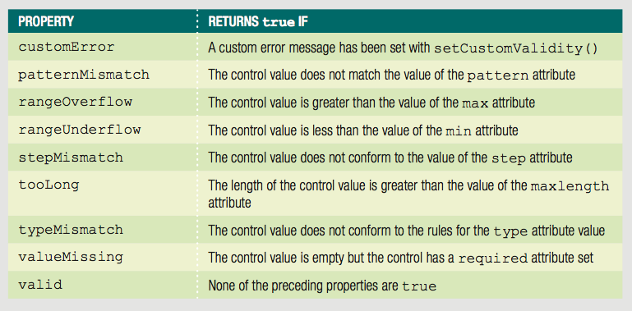
Browser-Based Validation
validity Object Properties

Slide 29
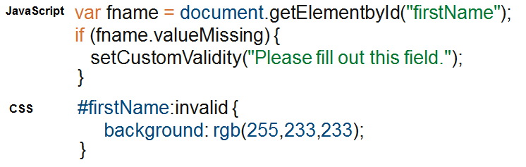
Browser-Based Validation
Customizing Browser-Based Validation Feedback
Use constraint validation API methods to set custom messages
Use in conjunction with CSS pseudo-classes

Slide 30
Browser-Based Validation
Programming Custom Validation
Browser-based validation still fairly limited and causes inconsistencies cross-platform
Bubble appearance varies among browsers
Cannot set multiple validation messages for a single field at once
Can disable browser-based validation
If disabled, must program custom validation

Slide 31
Browser-Based Validation
Programming Exercise 01_06_01 – Step 6
Setting up <form> for Custom Validation

Slide 32
Browser-Based Validation
Programming Custom Validation
Common validation functions
Checking that required fields contain entries
Checking values dependent on other fields
Checking for appropriate content type

Slide 33
Custom Validation
Validating Submitted Data
submit event fires when a <form> is submitted
Often when submit button selected
Data is usually validated when submit event fires
Use the preventDefault() method to disable default submit behavior of the event when it fires
If disabled, must program custom validation

Slide 34
Custom Validation
Programming Exercise 01_06_01 – Step 7
Create the Main Validation Function

Slide 35
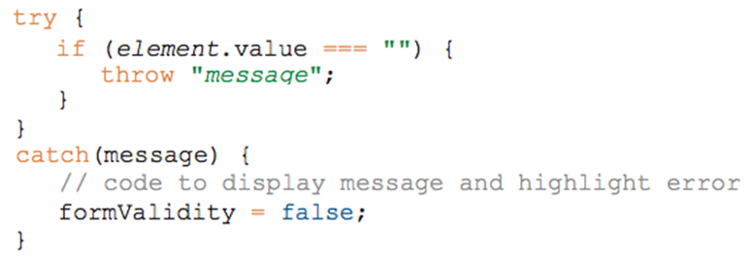
Custom Validation
Validating Required Fields
Very easy to do, check if any of them is empty
Most elegant way is to use a try / catch construct
Check the value attribute of the element
Very efficient to retrieve a group of fields and check them in a loop

Slide 36
Custom Validation
Programming Exercise 01_06_01 – Step 8
Validating Required Fields

Slide 37
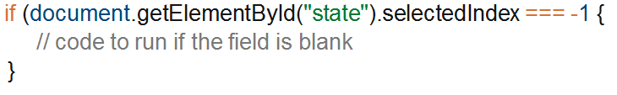
Custom Validation
Validating Selection Lists
Checking for selection lists with no values
Check value of selectedIndex property
If no option is selected, value is -1

Slide 38
Custom Validation
Programming Exercise 01_06_01 – Step 9
Validating Selection Lists

Slide 39
Custom Validation
Programming Exercise 01_06_01 – Step 10
Validating Date Selection Lists

Slide 40
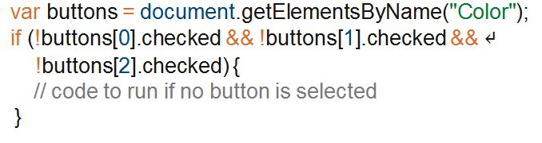
Custom Validation
Validating Option Button Sets
Checking for option button sets with no selection
Check value of checked property
Use logical && operators to check if no option button is selected

Slide 41
Custom Validation
Programming Exercise 01_06_01 – Step 11
Validating Option Button Sets

Slide 42
Custom Validation
Validating Dependent Fields
Sometimes the logic specific to a form can be more complex than single field tests
Field values can be dependent on other field values
Example: validating data in some field based on the state of some check box
Validation logic is said to be validating dependencies

Slide 43
Custom Validation
Programming Exercise 01_06_01 – Step 12
Validating Dependent Fields

Slide 44
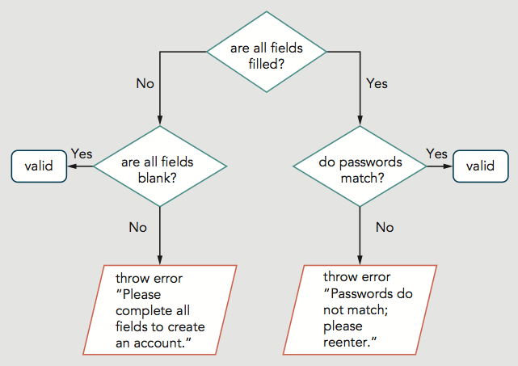
Custom Validation
Validating Multiple Dependent Fields
Sometimes validation logic specific to a form can be much more complex
May even need to use flowchart logic

Slide 45
Custom Validation
Programming Exercise 01_06_01 – Step 13
Validating Multiple Dependent Fields

